Slide 1
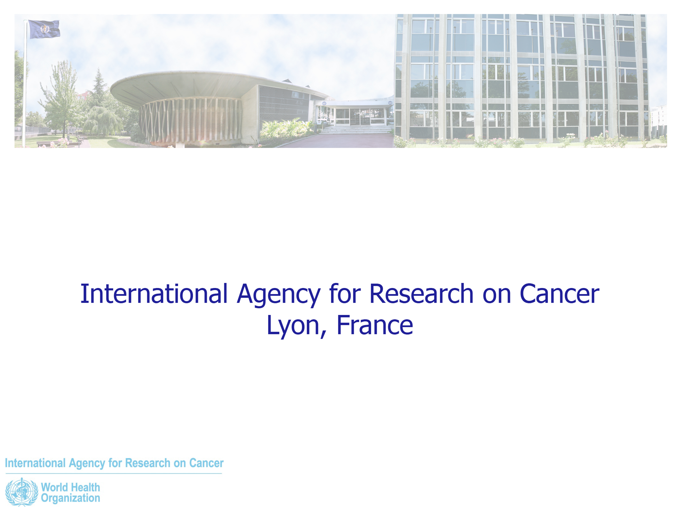
Perspectives on STIs in Eastern Europe
Vitaly Smelov, MD, CSc, PhD
Prevention and Implementation Group (PRI)
Early Detection and Prevention Section (EDP)
International Agency for Research on Cancer/WHO
21.07.2018
Amsterdam, the Netherlands

Slide 2
Disclosure
Nothing to Disclose

Slide 3
Outline
Generalities About “Eastern Europe”
Challenges and Opportunities
Trends on STIs in Eastern Europe
Summary

Slide 4
STIs: Global Public Health Problem
Global Estimates of New Cases of Curable Diseases in 2012
Four curable STIs:
  estimated 1 mln new infections/day (C. trachomatis = 37%)
WHO Report 2015 on global STI surveillance; WHO STIs 2016-2021;
Newman et al., PLoS One 2015

Slide 5
Estimated Incidence of Four Curable STIs
By WHO Region and Sex, 2012
WHO Sexually Transmitted Infections 2016-2021

Slide 6
Generalities About “Eastern Europe”

Slide 7
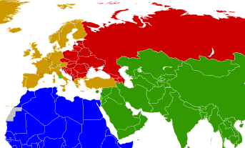
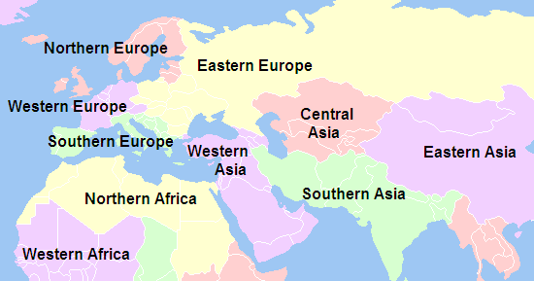
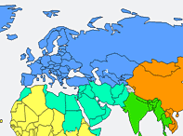
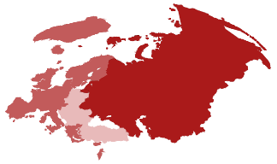

Eastern Europe?
No Standard for the Entire UN System
The UN Regional Eastern European Group
The UN Statistic Division (UNSD)
WHO Regions
Data source: unstats.un.org, who.it, euro.who.int

Slide 8
Semashko vs Beveridge (NHS) Health Systems
The Semashko Model
The Beveridge Model
1918; USSR, E. Europe, C. Asia, Mongolia, China
Universal free access – geographical emphasis
Under direct control of the central government
Entry point: policlinics, DV dispensaries, etc.
Extensive workforce (overall costs vs low salaries)
1948; UK, Scandinavia, Spain, N. Zealand
More room for private services
Entry point: family doctor/community services
Does not require extensive health care sector
Many Elements in Common:
Centralized, funded by the state, facilities mostly state-owned/budgeted, hospital physicians salaried
Data source: Maree and Groenewegen, NIVEL, 1997;
European Observatory on Health Systems and Policies, 2013
Notes:
The legacy of having been a highly centralized system focused on universal access to basic care still informs much of the discourse and practices in the system…

Slide 9
Challenges and Opportunities

Slide 10
Challenges
Bureaucracy and (related difficult to change) “traditions”
  zero errors admitted / no real culture of quality data (no real M&E)
  “traditions” on detection/treatment (Romanovsky, Ct DIF, AZI 21d, etc.)
  stigma (e.g. data on transmission routes in men remain unreliable)
Decreased/ing quality* (in some) and equity (in most countries)
  increased no. private clinics (data not provided)
  decrease in attending licensed public services / service quality
  increase in self-medication / services provided by non-specialists
Limited knowledge of international literature and guidelines
  Language barrier
  Common: denouncing/reporting of any (scientific) activities/studies
  (Any) Scientific publications may require high level of (political) approval
Low (although increasing) interest for research
  Low capacity (e.g. analysing data)
  Limited funds

Slide 11
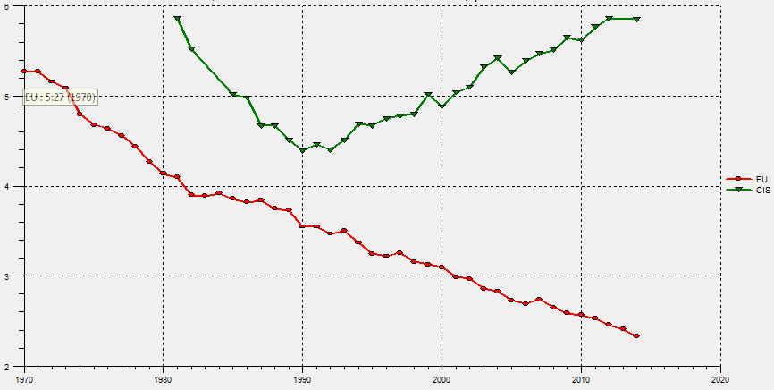
Example: Decreasing Coverage and Quality
Cervical Cancer Premature Mortality: EU vs CIS Since the 80’s
WHO estimates, up to to 2035:
  >0.5mln women develop CxCa in CIS countries and ¼ of them will die (2/3 before age 65)
Data source: WHO Europe,
Estimation based on Globocan database

Slide 12
Challenges
Bureaucracy and (related difficult to change) “traditions”
  zero errors admitted / no real culture of quality data (no real M&E)
  “traditions” on detection/traditions” (Romanovsky, Ct DIF, AZI 21d, etc.)
  stigma (data on transmission routes in men unreliable)
Decreased/ing quality *(in some) and equity (in most countries)
  increased no. private clinics (data not provided), corruption
  decrease in attending licensed public services / service quality
  increase in self-medication / services provided by non-specialists
Limited knowledge of international literature and guidelines
  language barrier
  common: denouncing/reporting of any (scientific) activities/studies
  (any) scientific publications may require high level of (political) approval
Low (although increasing) interest for research*
  low capacity (e.g. analysing data)
  limited resources or/and political will

Slide 13
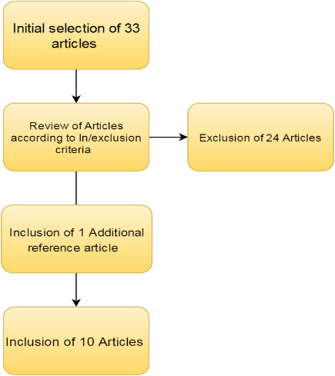
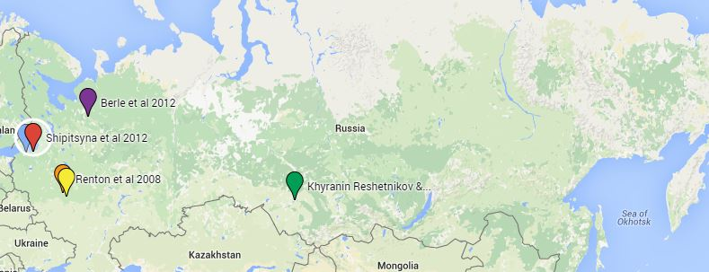
Example: Research & Publications
Prevalence of Genital Chlamydia Infections in Russia (Systematic Literature Review)
10 articles included,
Data from 4 regions
Smelov et al Pathogen and Diseases, 2017

Slide 14
Opportunities
Strong culture of registering data (first step to M&E)
    dispanserization & 4 curable STIs are reportable in the CIS
    health staff and public are OK with this
    politicians value this (?!)
Public health system* under 1 authority
    doesn’t exclude inequity
Clear partners for international assistance and cooperation
    build up national capacity
Human resources can (relatively) easily be allocated
    numerous health staff

Slide 15
Example: Belarus Health System
European Observatory on Health Systems and Policies, 2013
Notes:
MoH:

Slide 16
Example: Uzbek Health System
European Observatory on Health Systems and Policies, 2014
Notes:
MoH:

Slide 17
Example: Russian Health System
European Observatory on Health Systems and Policies, 2011
Notes:
MoH:

Slide 18
Opportunities
Strong culture of registering data (first step to M&E)
    dispanserization & 4 curable STIs are reportable in the CIS
    health staff and public are OK with this
    politicians value this (?!)
    STI case management based on lab and individual clinical diagnosis
Public system under 1 authority
    *doesn’t exclude inequity
Clear partners for international assistance and cooperation
    build up national capacity
Human resources can (relatively) easily be allocated
    numerous health staff
    almost universal provision of STI care through DV clinics
Increasing interest for research
    trained staff

Slide 19
Trends

Slide 20
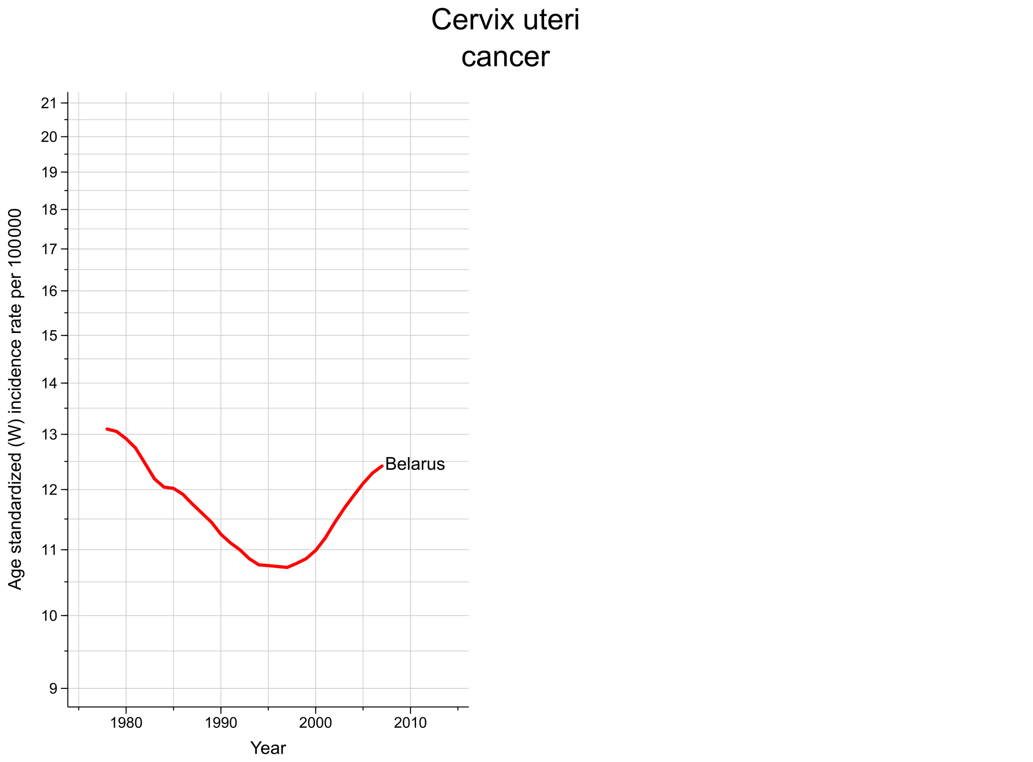
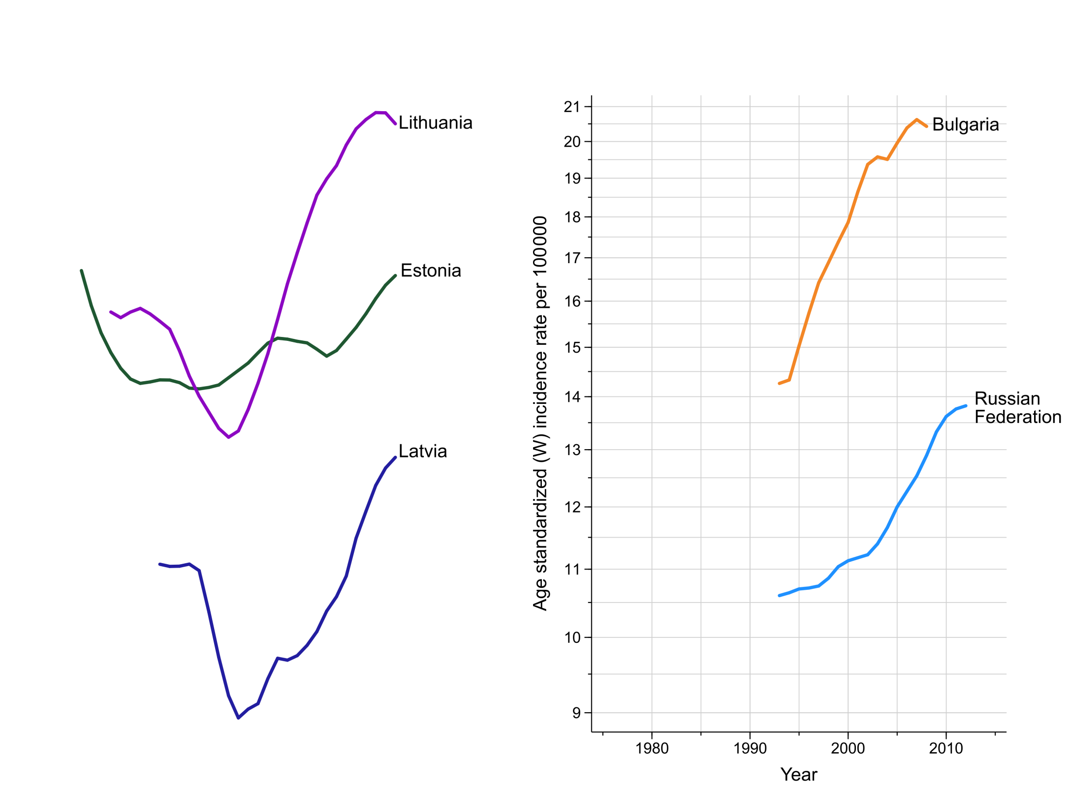
Trends in Cervical Cancer Incidence
Age-standardized (World) Incidence per 100,000 Women
Cancer Incidence in Five Continents: http://ci5.iarc.fr

Slide 21
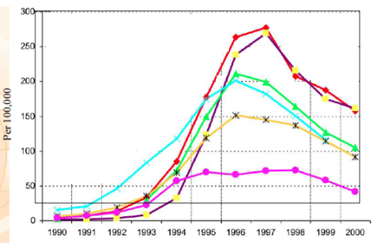

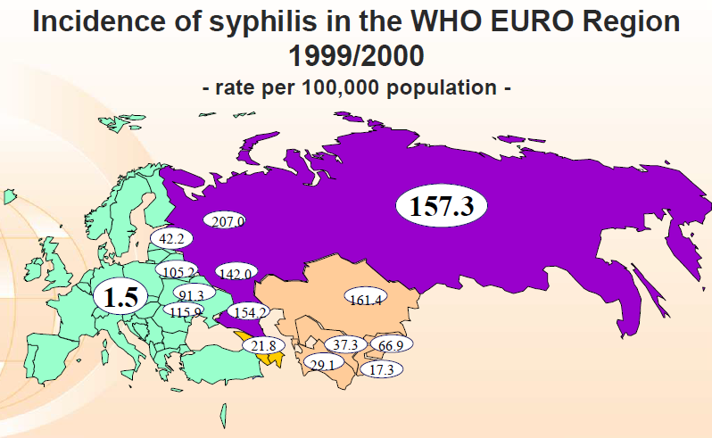
Trends in Syphilis: E. Europe and C. Asia
Per 100,000 People, 1990-2005
Acknowledgments to: Igor Toskin, WHO 2007;
Uuskula et al, Sex Transmit Infect, 2010

Slide 22
Trends in Gonorrhea: Russia
Per 100,000 People, 1996-2005
Uuskula et al, Sex Transmit Infect, 2010

Slide 23
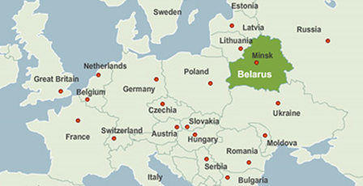
Trends in STI Incidence: Belarus
Per 100,000 People, 2002-2017
Syphilis
Gonorrhea
Trichomoniasis
Chlamydiosis
Acknowledgements to: Dr. Grankov, WHO Belarus; Prof Lukyanau, Ministry of Public Health of Belarus;
Map image: Image: www.belarus.by

Slide 24
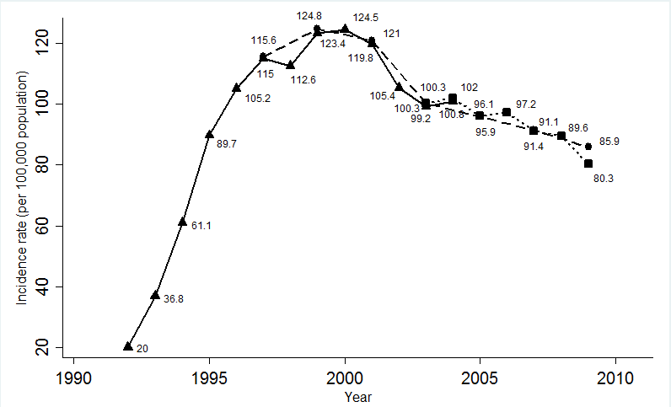
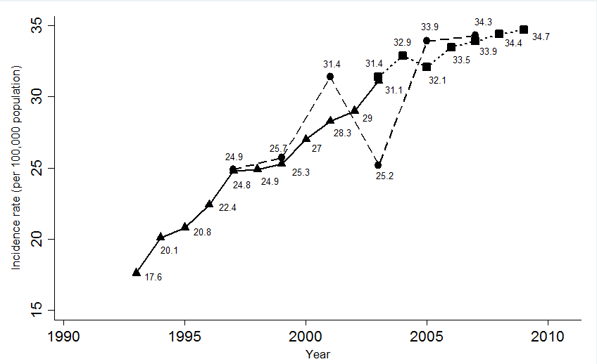
Trends in Chlamydia and HPV infections: Russia
Per 100,000 People, 1990-2010
Ivanova et al, 2009; Kubanova et al, 2010; WHO data on STIs 2017

Slide 25
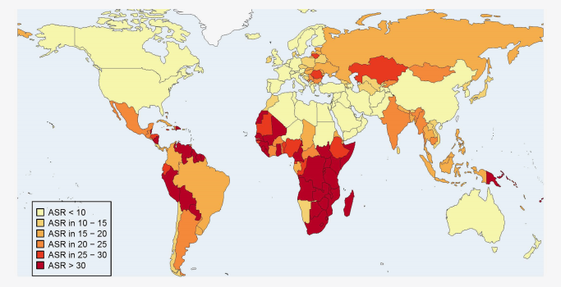
HPV-caused Cervical Cancer Incidence
Estimated Age-Standardized rates (World), 2012
de Martel et al. (2017). Worldwide burden of cancer attributable to HPV by site, country and HPV type

Slide 26
HIV Incidence: Common Facts
Data source: UNAIDS 2017

Slide 27
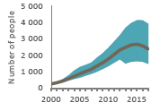
New HIV Infections / AIDS Deaths, 2010-2017
Russia:
Belarus:
Ukraine:
+35%
N/D
+34%
+156%
-16%
-41%
Kazakhstan:
Kyrgyzstan
Uzbekistan
+106%
+53%
-27%
+45%
+77%
+5%
Georgia
All Countries
-10%
+86%
+29%
+0.1%
UNAIDS Data 2018

Slide 28
Take-Home Messages
Including Diagnostics, Care and Prevention

Slide 29
Lessons Learned
Past (1990’s)
Elimination most social-safety mechanisms (abrupt free-market transition) →sharpest rise in extreme poverty/migration
STI increased incidence & unclear real numbers (insufficient reporting)
Many (poorly if any controlled) providers of services
Free access to antibiotics (+ pharma’s role) → Common self-treatment
Insufficient STI testing
    expensive (NAATs) or
    poor (DIF, serology, etc.) quality
Rocketing incidence of (mostly bacterial) STIs

Slide 30
Call for Actions (and Research Opportunities)
Present Days (2000’s)
More pluralistic health systems in transition (funding/management)
STI incidence rates: decreased bacterial vs increased viral
HIV expanding epidemic*
Suboptimal reporting systems: real numbers remain unclear
No data on high-risk populations* (e.g. increasing MSM stigma)
Improved (most countries) STI diagnostics
- Local manufacturers* and lab chains (controlling the market)
Still easy access to antibiotics
Limited (if any, except pharma-driven) international collaboration

Slide 31
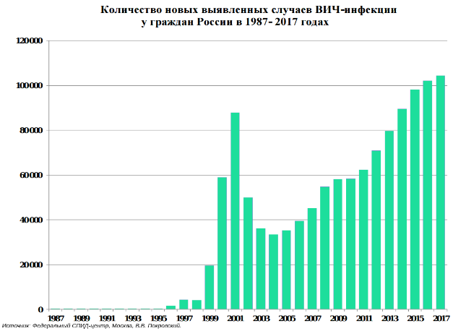
HIV in Russia: Common Facts
Incidence
HIV incidence = 71.1/100,000; total No. HIV+: ~1mln (every 50th of 30-39yo)
New HIV+ identified: >104k in 2017 & >20k in 2018QI (1% children)
UNAIDS: Russia is behind S. Africa and Nigeria; PEPFAR: highest rate in 2017
Mortality
53% of all deaths from infectious diseases due to HIV/AIDS
Data source: Russia Federal AIDS Center, Federal Statistic Agency ROSSTAT; UNAIDS 2018: PEPFAR 2018;
Image sources: https://spid-vich-zppp.ru; Science 2018 http://www.sciencemag.org

Slide 32
Call for Actions (and Research Opportunities)
Present Days (2000’s)
More pluralistic health systems in transition (funding/management)
STI incidence rates: decreased bacterial vs increased viral
HIV expanding epidemic*
Suboptimal reporting systems: real numbers remain unclear
No data on high-risk populations* (e.g. increasing MSM stigma)
Improved (most countries) STI diagnostics
- Local manufacturers* and lab chains (controlling the market)
Still easy access to antibiotics
Limited (if any, except pharma-driven) international collaboration

Slide 33
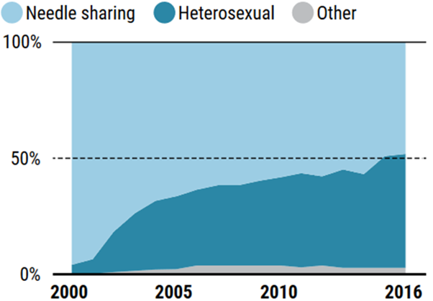
HIV+ MSM in Russia
Hidden Reality?
43.6% – IDU
53.5% – heterosexual
2.3% – MSM*
Data source: Russia Federal AIDS Center, Federal Statistic Agency ROSSTAT;
Image sources: https://spid-vich-zppp.ru; Science 2018 http://www.sciencemag.org

Slide 34
Call for Actions (and Research Opportunities)
Present Days (2000’s)
More pluralistic health systems in transition (funding/management)
STI incidence rates: decreased bacterial vs increased viral
HIV expanding epidemic*
Suboptimal reporting systems: real numbers remain unclear
No data on high-risk populations* (e.g. increasing MSM stigma)
Improved diagnostics of STIs (in most countries)
- Local manufacturers* and lab chains (dominating the market)
Still easy access to antibiotics
Limited (if any, except pharma-driven) international collaboration

Slide 35
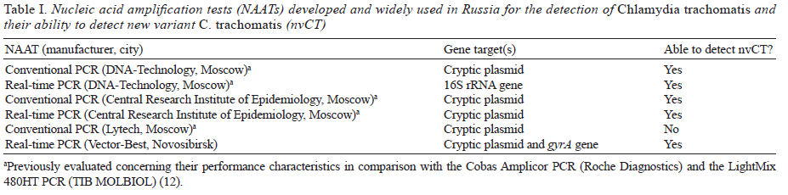
Detection of a Ct New Variant in Russia
Local Tests can be Used to Decrease Detection Costs (i.e. in Future Studies)
CE-IVD marked
Shipitsyna et al., 2009; 2012

Slide 36
Call for Actions (and Research Opportunities)
Present Days (2000’s)
More pluralistic health systems in transition (funding/management)
STI incidence rates: decreased bacterial vs increased viral
HIV expanding epidemic
Suboptimal reporting systems: real numbers remain unclear
No data on high-risk populations (e.g. increasing MSM stigma)
Improved diagnostics (in most countries) of STIs
- Local manufacturers and lab chains (dominating the market*)
Still easy access to antibiotics, suboptimal treatment of HIV+
(If any, except pharma-driven) limited international collaboration

Slide 37
Summary:
What Can Be Seen as the Challenges and Opportunities for Programmes on STIs in Eastern Europe?
Changing Paradigms
Ensuring Failsafe Solutions
Promoting National Champions

Slide 38
21.07.2018
Amsterdam, the Netherlands

